Slide 1


Successful Aging through Financial Empowerment

Slide 2
SAFE
Created in 2017
Housed in the Wayne State University Institute of Gerontology in Detroit, MI
Provides no cost, virtual 1 on 1 services to caregivers and older adults to address financial exploitation and financial management
Provides no cost presentations for older adults, caregivers and professionals

Slide 3
SAFE Program Goals
To help victims recover their financial footing after being victims of scams and identity theft.
Assist caregivers in proper financial management of their charge's assets and finances
Enhance public education around scams and identity theft through public presentations
Enhance caregiver education on Managing the Finances of their charges

Slide 4
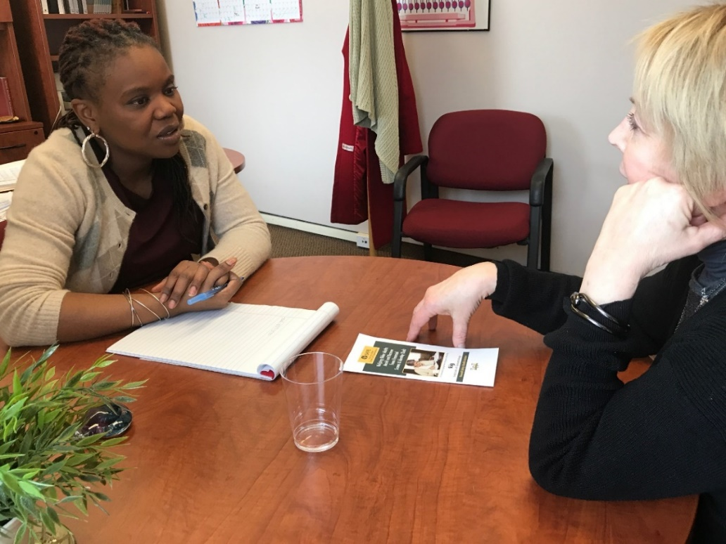
What We Do!!!
NO COST
Phone and Virtual Coaching/Advocacy sessions
Help older adults recover financially and emotionally after being victimized by financial scams or identity theft.
Educate older adults, and the people who care for them, about scamming and identity theft techniques, identification, protection and reporting.
Offer one-on-one support and education to caregivers on financial management issues

Slide 5

How We Help
Older Adults
We can help with
•Filing police and consumer reports
•Contacting credit report agencies
•Disputing information on your credit report
•Contacting creditors and closing accounts
•Placing fraud alerts on your credit report
•And more...

Slide 6

How We Help Caregivers
We can help with
Obtaining the necessary legal documents and designations to manage a friend or relative’s finances.
Proper record-keeping.
Filing consumer complaints and crime reports
Reviewing credit reports and addressing credit issues
Preparing personal budgets and care recipient budgets
Coaching on difficult conversations
Financial coaching services for caregiver financial issues
And more….

Slide 7





Ten Most Costly Scams for Older Adults
(AARP, 2020)
1. Romance Scams $83.7 million
2. Impostor: Government: $61 million
3. Prizes, Sweepstakes and Lotteries: $51.4 million
4. Impostor: Business $34.3 million
5. Investments $25.4 million
6. Computer Tech Support Scams $24.1 million
7. Timeshare Sales $17.4 million
8. Impostor: Family/Friends $17.1 million
9. Online Shopping $14.2 million
10. Timeshare Resales $12.5 million
https://www.aarp.org/money/scams-fraud/info-2020/ftc-top-scams.html

Slide 8
SAFE Metrics
Saved or Recovered
Approximately $135,000
Provided NO COST, One on One Services
135 Older Adults
45 Caregivers
Educated over 10,000 Older Adults,
Caregivers and Professionals

Slide 9

SAFE Scam Case
Relative in Distress Scam
83 year old woman contacted by phone
Attempted a $20,000 wire transfer
Teller denied a second wire transfer of $10,000
Went to another bank and wired the funds
Made a $20000 withdrawal and mailed in a magazine
Made a $15000 withdrawal and was going to have the scammers pick it up.
Caregiver found out and told family.
Older adult did not hand over the funds after family intervened.

Slide 10
SAFE Scam Case Cont….
How SAFE helped
Reported the crime: Local Police, FTC, AARP Fraud watch
Counseled family and older adult on scam risks and how to monitor behavior for reflags.
Connected family to Universal Dementia Caregivers to receive some support on caregiving dynamics.
Unable to recover funds. Older adult lost $50,000

Slide 11

SAFE Identity Theft Case
63 Year Old Woman
Turned down for auto loan by her bank
Was referred to SAFE by bank staff to look over her credit and investigate the drop in her credit score.
Uncovered many fraudulent accounts totaling approximately $5000 in debt.
Worked with client to contact creditors, complete police reports, complete fraud affidavits, completing creditors fraud resolution process, placed fraud alert on credit report.
Saved $5000 through resolving fraudulent debt.

Slide 12
Caregiver Case
Daughter had legal guardianship over mother after sister who formerly had guardianship had been found to be stealing money from mother.
Mother was in a nursing home
Sister, who was formerly guardian, had mother to cosign for $8000 in student loans for granddaughter.
Contacted the Dept of Education
Contacted the loan servicer.
Submitted guardianship paperwork, proving mother was not in a position to make decisions for herself.
Blocked disbursement of student loans
Amount saved $8000

Slide 13
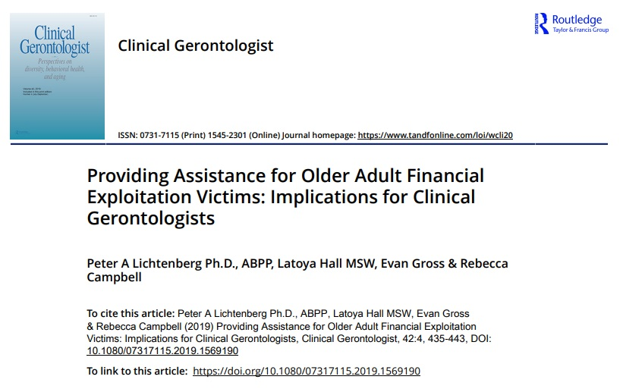

Slide 14
Study used baseline data to describe the program and methodology and uses case examples and preliminary research to investigate the intersection of FE and physical and mental health functioning.
42 Community Dwelling Older Adults
21 SAFE
21 Community Comparison Group
Lichtenberg et al (2019)

Slide 15
Lichtenberg et al (2019) (Cont…)
Results
SAFE Clients Compared to Older Adults with No Complaint of Scams and ID Theft
Less Education
Worse Health
More Functional Deficits
More Cognitive Deficits
More Financial Hassles
Less Social Support
Higher Levels of Stress Anxiety and Depression
Higher LFDRS Risk Scores

Slide 16
Hall, L., Campbell, R., Gross, E. & Lichtenberg, P. (2021). The Impact of Financial Coaching on Older Adult Victims of Financial Exploitation: A Quasi Experimental Research Study. Journal of Financial Counseling and Planning, 33(1), 66-78.

Slide 17
Hall et al., (2021)
The study used baseline and follow up assessment data to investigated the impacts of a financial coaching program on the financial, neurocognitive, physical, and emotional health of older adult victims of FE.
40 Community Dwelling Older Adults
20 SAFE
20 Community Comparison Group
Neither group experienced any further declines in cognition, physical health or mental health measures from baseline to follow up.
SAFE group showed a significant decrease in stress.

Slide 18
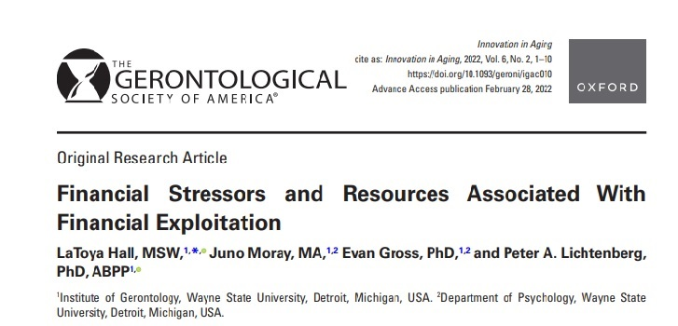
This study examined the associations described in our proposed conceptual framework to better understand older adults’ vulnerability to FE causing financial hardship.

Slide 19
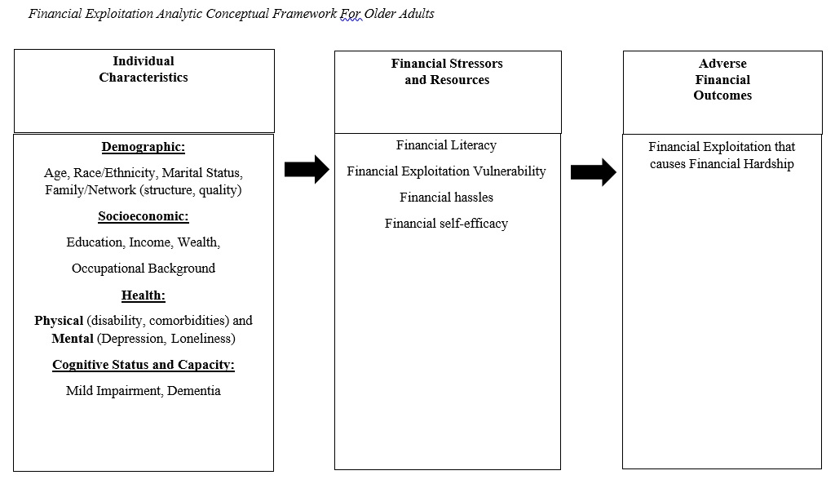

Slide 20
142 Participants
62 SAFE- History of FE causing financial hardship
80 LFDRS - No history of FE
Sample Characteristics
83% African American
78.9% Female
79.6% Unmarried
Average Age 69.55
Average Education 14.39 year

Slide 21
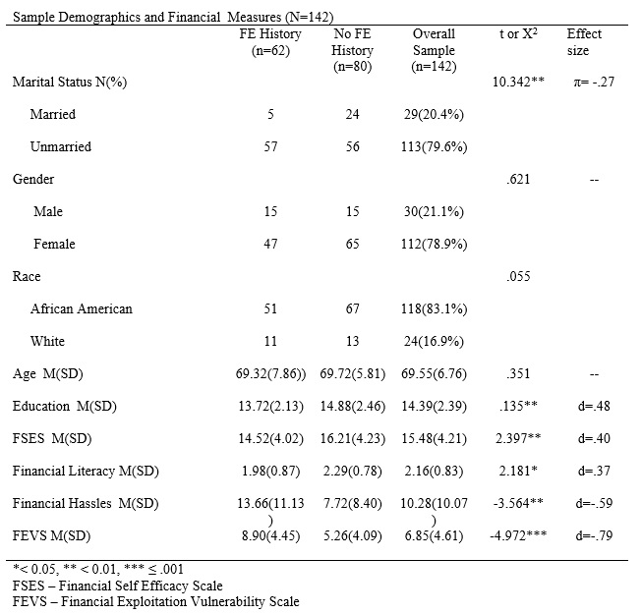

Slide 22
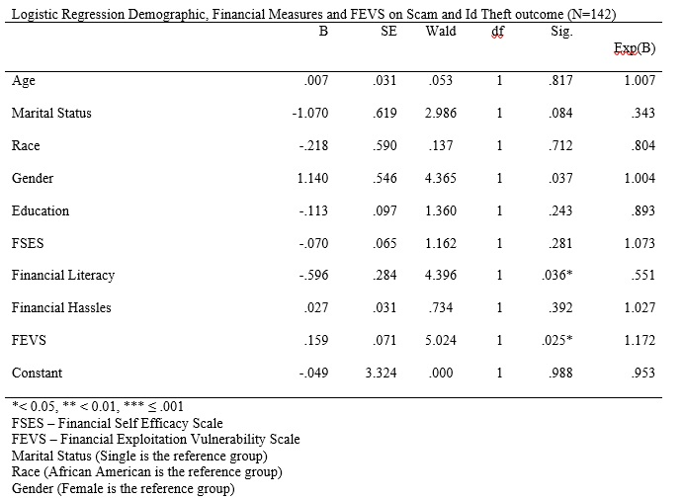

Slide 23
Hall, Gomez & Lichtenberg (2023) Trust and Betrayal in Older Adult Financial Exploitation (Forthcoming: Aging and Mental Health)
The purpose of this study is to use BTT (e.g., Freyd, 1996) to elucidate the impacts of elder family financial exploitation on older adult victims, given that elder family financial exploitation entails a close other who perpetrates the harm. We examined the associations between mental health conditions and elder family financial exploitation (i.e., a form of high betrayal trauma) compared with the mental health conditions of older adults who have been financially exploited by strangers.

Slide 24
Amount Lost and Stress
95 Participants
32 Exploited by Trusted Others
63 Exploited by Strangers

Slide 25
FEVS and Functional Status

Slide 26
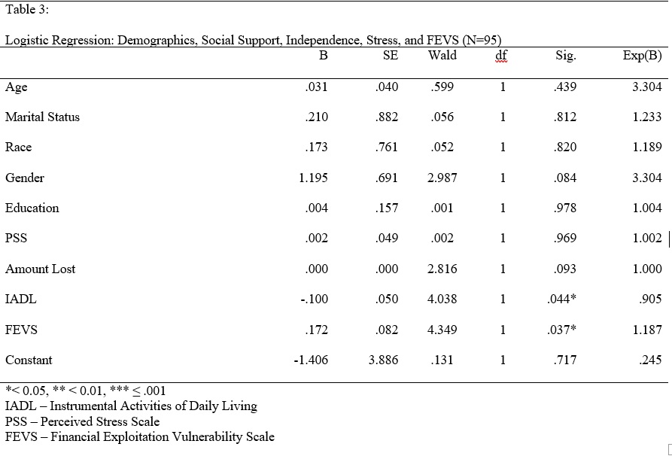

Slide 27


SAFE Coaching Services
Zoom and/or Telephone Coaching/Advocacy Services for Older Adults
No Cost
No Cost
Contact
LaToya Hall
313-664-2608
L.hall@wayne.edu

Slide 28
Who to Refer
55 and Over
Victim of Financial Exploitation
Individuals with Local Advocates who can work with them through the process

Slide 29
Thank
You

