Slide 1


Bringing Evidence-Based tools to
Financial Exploitation Investigation and Prevention
  Peter A. Lichtenberg, Ph.D., ABPP
  p.lichtenberg@wayne.edu
  Director & Distinguished University Service Professor of Psychology

Slide 2

Disclosure
Peter Lichtenberg Consultancy, LLC designed to maximize the exposure and usage of
financial vulnerability tools and training.

Slide 3
Overview for today’s talk
Introduce
Introduce a “real world” approach to financial capacity assessment and financial exploitation investigation
Examine
Examine our evidence-based person-centered decision-making and vulnerability tools
Describe
Describe our website https://olderadultnestegg.com for professionals, caregivers and older adults.
Call
Call to Action!

Slide 4
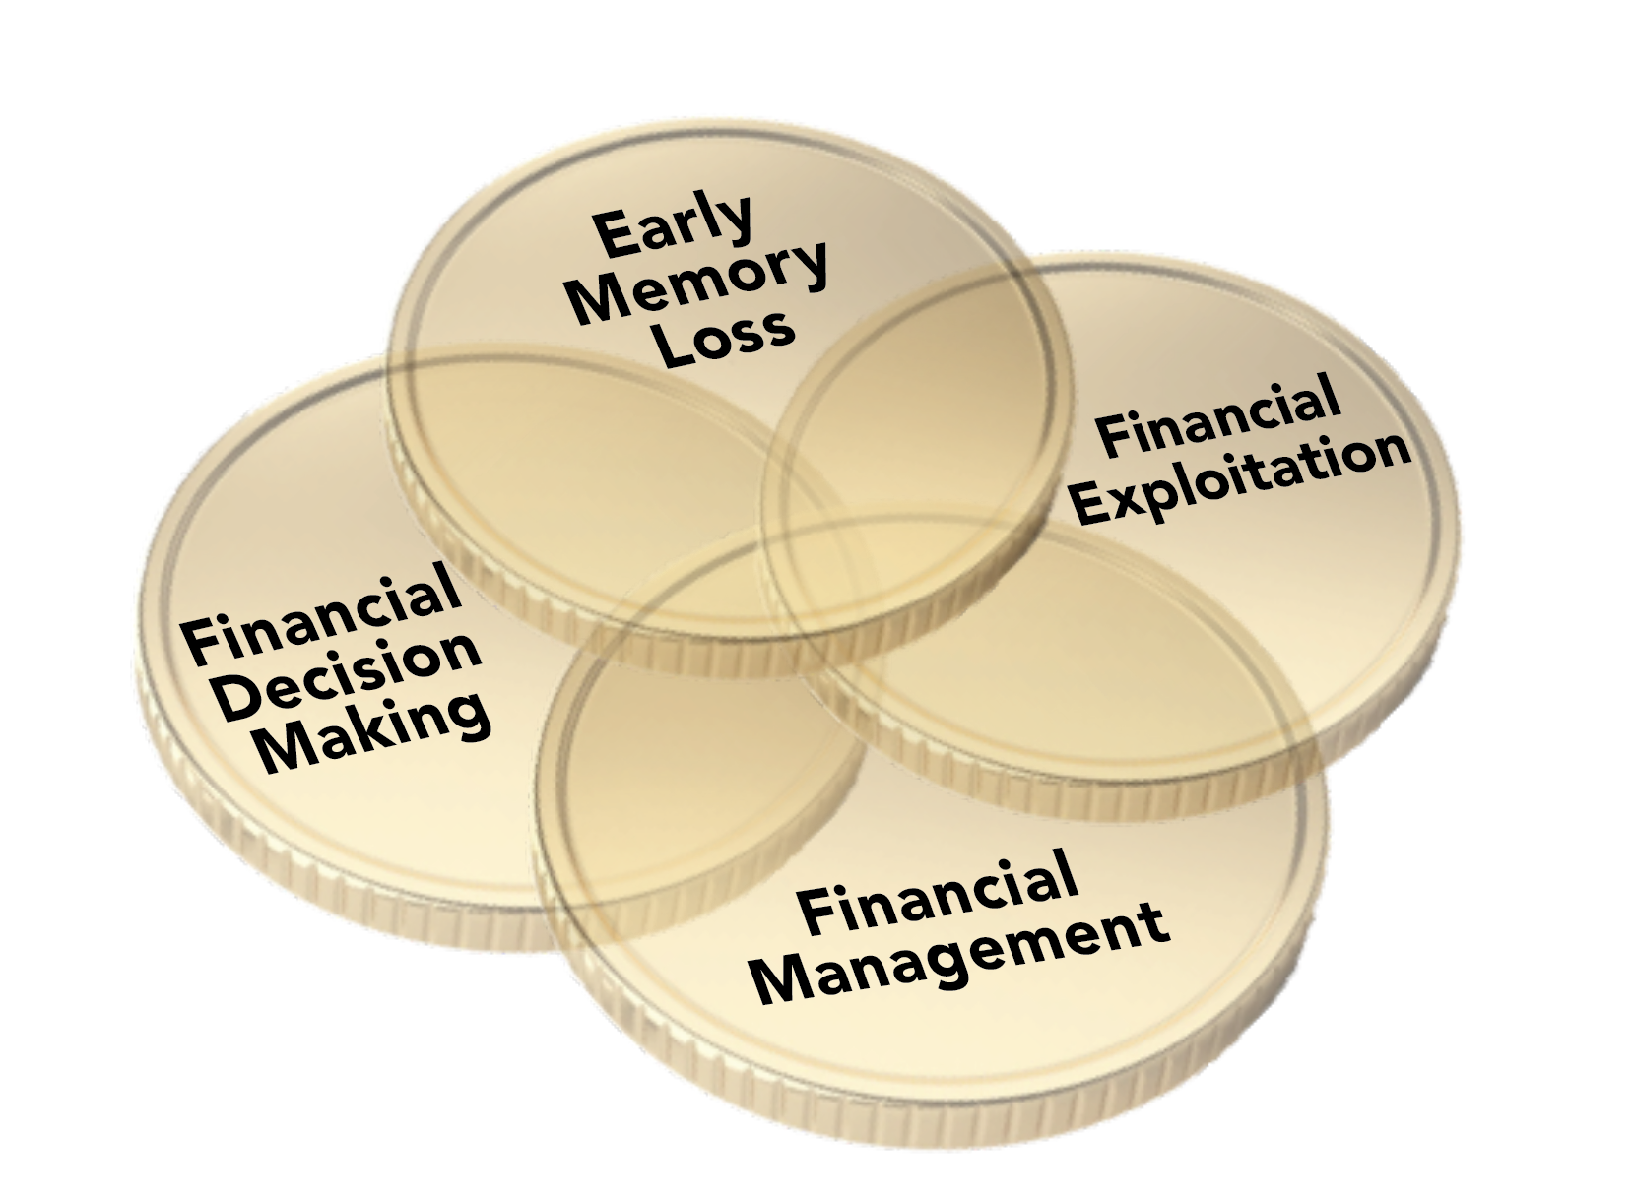
The Domains of Financial Capacity: Financial Management, Financial Decision Making and Avoiding Financial Exploitation

Slide 5
Defining Financial Exploitation
Misappropriation or misuse
of the funds of an older and/or
vulnerable adult
Includes fraud, family or friend exploitation,
exploitation by staff or professionals
https://www.olderadultnestegg.com

Slide 6
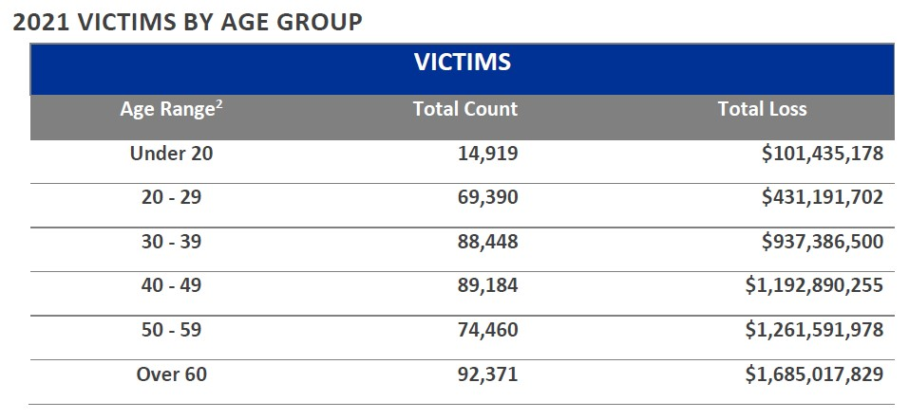
Statistics from the Elder Fraud Report (2021) of the Federal Bureau of Investigations

Slide 7
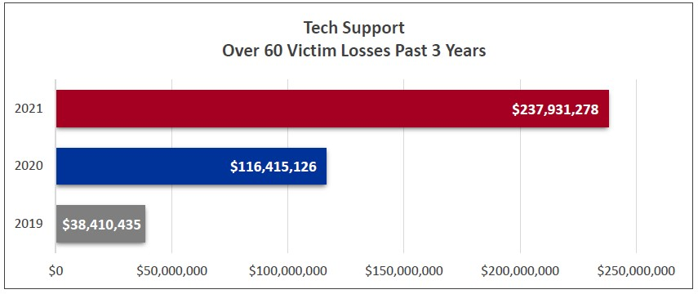

Slide 8
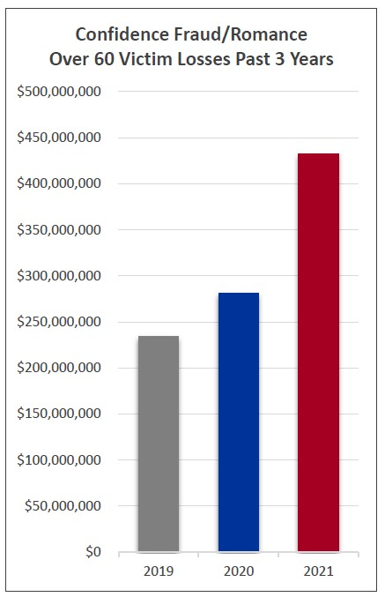
Notes:
I kept this very simple. These are smart folks who can read, so once they get onto the site, the OANE instructions should move them through it easily.

Slide 9
Financial Exploitation: What Is It?
Six Domains*
*Conrad et al. (2010)
Theft & Scams
Has anyone misused your ATM or credit card?
Abuse of Trust
Has someone convinced you to turn the title of your home over to them?
Financial Entitlement
Has anyone felt entitled to use your money for themselves?
Coercion
Did anyone put pressure on you to get a reverse mortgage?
Signs of Possible Financial Exploitation
Has anyone been frequently asking you for money?
Money Management Difficulties

Slide 10
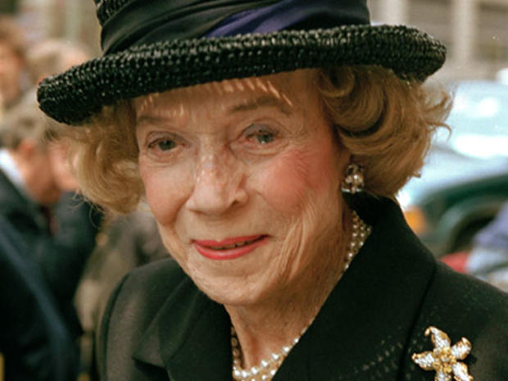
Brooke Astor, NYC Philanthropist and Socialite financially exploited by son
Brooke Astor had Alzheimer’s Disease

Slide 11
Cognitively Unimpaired
Mild Cognitive Impairment
Mild Dementia
Moderate Dementia
Severe Dementia
CONTINUUM OF COGNITIVE IMPAIRMENT
Impairment does not interfere with activities of daily living
Impairment in two or more cognitive functions that interfere with activities of daily living
MCI is a known risk factor for dementia

Slide 12

Loneliness and Psychological Vulnerability cause risk for scams

Slide 13
Lichtenberg et al. 2013 & 2016
Psychological Vulnerability
2013: The strongest finding, however, was the prevalence of fraud
in persons with the highest depression and lowest social-needs
fulfillment (14%) compared to the prevalence of fraud in the
rest of the sample (4.1%; X2= 20.49; p < .001)
2016: Fraud prevalence among those with clinically significant depression
and the lowest 10% in social-needs fulfillment (8.7%) was more than
twice as high compared to the rest of the sample (4.1%; χ2 = 7.85, p = .005).
https://www.OlderAdultNestEgg.com

Slide 14
Both under and over-protection of older adults can lead to damaging consequences
Under protection for older adults can lead to gross financial exploitation that can impact every aspect of the older adult’s life.
Over protection can be equally as costly. Many older adults have very strong needs for autonomy and control and to unnecessarily limit autonomy can lead to increased health problems and shortened longevity.
Key Question in Elder Justice: Integrity of Financial Judgment

Slide 15
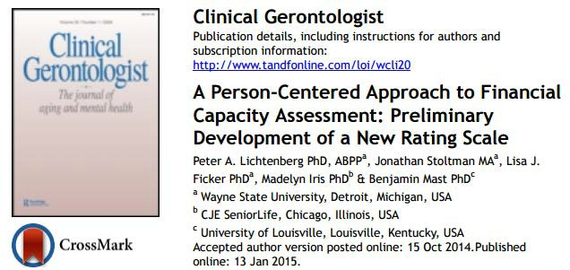


https://www.OlderAdultNestEgg.com

Slide 16
Using Person-centered Principles for Financial Decision-Making Capacity
Mast (2011) Whole Person Dementia Assessment approach; integrates person-centered ideas with standardized assessment
Context matters
Voice of older adult is critical
Real life decisions vs. vignettes

Slide 17
Groundbreaking Work of Appelbaum and Grisso 1988
Originally for capacity for psychiatric treatment and guardianship, then health decisions
Identified 4 aspects of Informed decision-making
  Communicating:
    Choice
    Understanding
    Appreciation
    Reasoning

Slide 18
Conceptual Model for the Lichtenberg Financial Decision Rating Scale
(LFDRS)
Identify Four Aspects of Decision-Making Communicating:
Contextual Factors
Financial Situational Awareness
Psychological Vulnerability
Susceptibility
Intellectual Factors
Express:
Choice
Rationale
Understanding
Appreciation
Integrity of Financial Decisional Ability (Capacity)
Consistency with Values

Slide 19
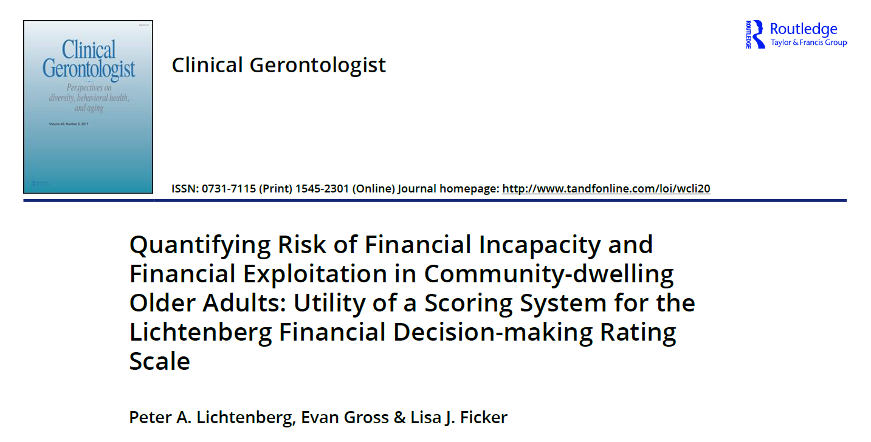

Slide 20
Findings from Study
N=200 community Living Adults: 18% experienced FE in last 18 months
Those with FE more likely to have decision-making deficits
Those with FE more likely to have possible cognitive decline

Slide 21
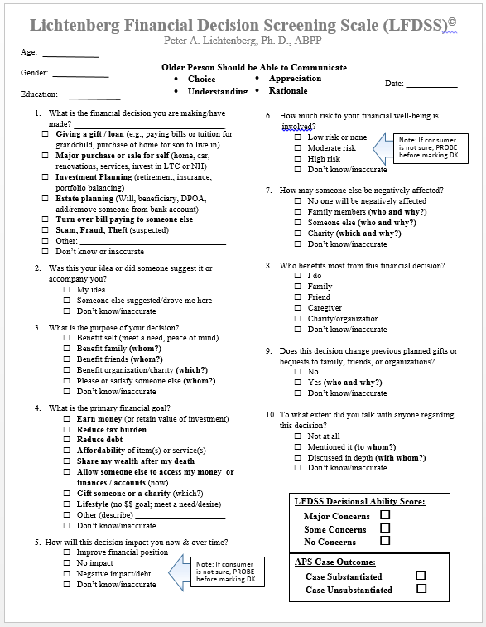
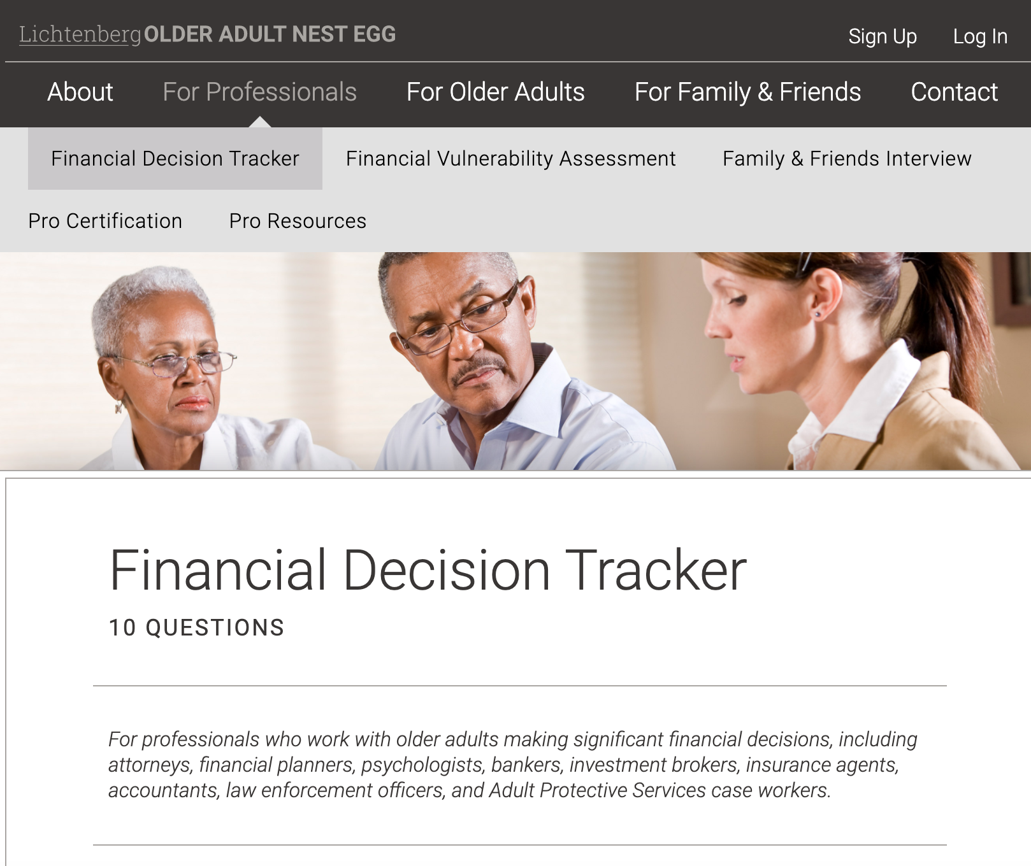
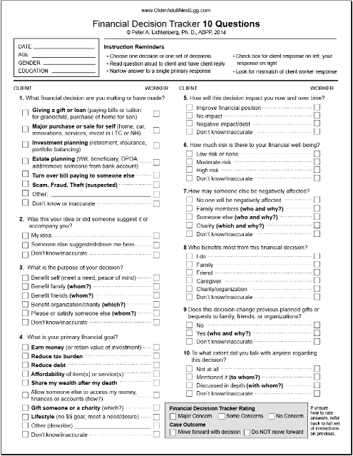
Lichtenberg Financial Decision Screening Scale (LFDSS)
AKA –
“Financial Decision Tracker”(FDT)
Foundational to the Rating Scale
https://www.OlderAdultNestEgg.com

Slide 22
FDT contains 10 items
Financial Decision Tracker (FDT) - 10 Questions
Approximate time: 10 min.
| www.OlderAdultNestEgg.com
| © Peter A. Lichtenberg, PhD, 2014
1. Obtain client’s consent to administer FDT inter^{view.}
A. Client Name
2. Read questions and answers to client as written. ^{Mark only one left}
circle for your client’s response.
DATE OF BIRTH
AGE
3. Mark the response you believe is most accur^{ate in right circle.}
CLIENT ID #
/
/
Consent/Instructions
4. To support your answers take notes on line ^{provided or back of sheet.}
RACE/ETHNICITY
5. Once completed, note each mismatch by marking ^{“Inaccurate” box.}
GENDER
HIGHEST LEVEL OF EDUCATION
For complete instructions visit: www.olderadultnestegg.com
SIGNATURE OF INTERVIEWER
DATE
B. Interviewer Name (PRIN^{T)}
INTERVIEWER ID#
/ /
To receive a Risk Score, you must enter this interview at: www.OlderAdultNestEgg.com
C. Final Score
No Concerns
Some Concern Major Concerns
D. OlderAdultNestEgg.com ^{Interview #}
INTERVIEWER JUDGMENT
An overall risk score is assigned using seven of the items. For example, if the financial decision poses a high risk or entails significant changes to previously established bequests, a higher risk score would be assigned than in cases of minimal financial from risk or no changes to bequests.
The other three items are descriptive and neutral— for instance, there is no way to determine whether a new will is riskier than a new investment or gift
INTERVIEWER JUDGMENT
CLIENT RESPONSE
>
CLIENT RESPONSE
>
>
>
5. How will this decision impact you now and ^{over time?}
1. What financial decision are you making or ^{have made?}
a. Improve financial position
a. Giving a gift or loan
b. No impact
(pay bills/tuition for grandchild, purchase home ^{for child)}
c. Negative impact/debt
b. Major purchase or sale
d. Don’t know
Inaccurate
(home, car, renovations, services)
c. Investment planning
6. How much risk is there to your financial well-being?
(retirement, insurance, portfolio balancing)
a. Low risk or none
d. Estate planning
b. Moderate risk
(Will, beneficiary, add/remove someone from bank ^{account)}
c. High risk
e. Turn over bill paying to someone else
d. Don’t know
Inaccurate
f. Scam, fraud, theft (suspected)
g. Other (describe)
7. How might someone else be negatively affected?
h. Don’t know
Inaccurate
a. No one will be negatively affected
2. Was this your idea or did someone else suggest ^{it or}
b. Family member(s) (who & why?)
accompany you?
c. Someone else (who & why?)
a. Your idea
d. Charity (which & why?)
b. Someone suggested/accompanied you (who?)
e. Don’t know
Inaccurate
c. Don’t know
Inaccurate
8. Who benefits most from this financial decision?
3. What is the primary purpose of your decision?
a. You do
a. Benefit you (meet a need, peace of mind)
b. Family (who?)
b. Benefit family (who?)
c. Friend (who?)
c. Benefit friends (who?)
d. Caregiver (who?)
d. Benefit organization/charity (which?)
e. Charity/organization (which?)
e. Please or satisfy someone else (who?)
f. Don’t know
Inaccurate
f. Don’t know
Inaccurate
9. Does this decision change previous planned ^{gifts or bequests}
4. What is your primary financial goal for this ^{decision?}
to family, friends, or organizations?
a. Earn money (or retain value of investment)
a. No
b. Reduce tax burden
b. Yes (who & why?)
c. Reduce debt
c. Don’t know
Inaccurate
d. Affordability of item(s) or service(s)
10. To what extent did you talk with anyone rega^{rding this decision?}
e. Share wealth after your death
f. Allow someone else to access your money, finance^{s or}
a. Not at all
accounts (how?)
b. Mentioned it (to who?)
g. Gift someone or a charity (which?)
c. Discussed in depth (with who?)
h. Lifestyle (no monetary goal; meet a need/desir^{e)}
d. Don’t know
Inaccurate
i. Other (describe)
j. Don’t know
Inaccurate

Slide 23
Financial Decision Tracker (FDT)
10 items: Administered in an interview format
Multiple choice
Focuses on the 4 intellectual factors and potential for undue influence
Professional does the rating on each item and does not just record older adult’s responses
Overall judgment score based in part on don’t know or inaccurate responses

Slide 24
10 Questions from LFDSS
What is the financial decision you are making? Choice
Was this your idea or did someone suggest it or accompany you? Autonomy
What is the purpose of your decision? Rationale
What is the primary financial goal? Understanding
How will this decision impact you now and over time? Understanding
How much risk is involved? Appreciation
How may someone else be negatively affected? Appreciation
Who benefits most from this financial decision? Understanding
Does this decision change previous planned gifts or bequests to family, friends, or organizations? Appreciation
To what extent did you talk with anyone regarding this decision? Autonomy

Slide 25

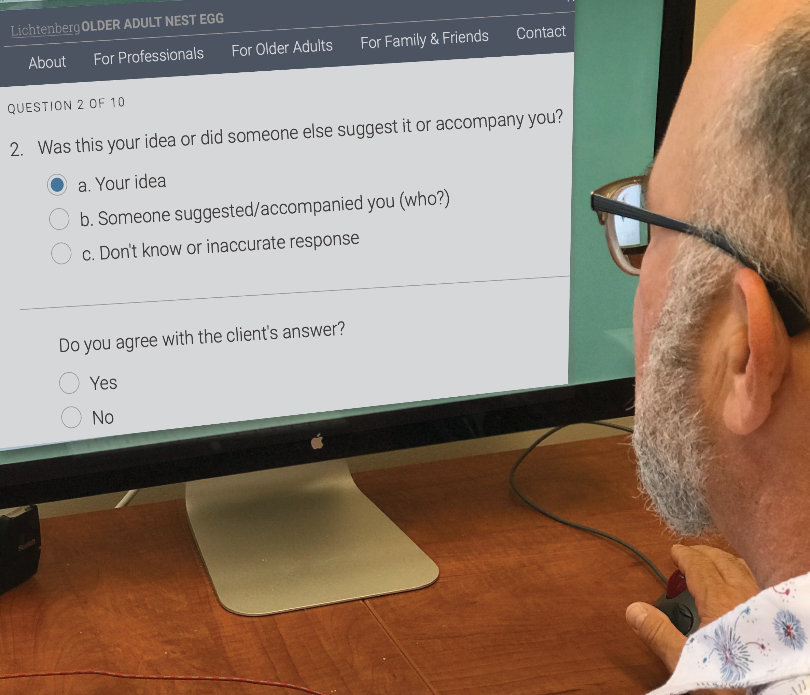
The FDT is a rating scale, and Therefore the APS Interviewer’s Judgment is Critical
Record all each interview using the online tool in OlderAdultNestEgg.com
On each item, the interviewer will be asked whether they agree that this is the most accurate response.
Upon entering all answers in OlderAdultNestEgg the website will produce a risk score and suggested level of concern about the individual’s informed decision-making. The interviewer will then make a final rating of the level of concern regarding informed decision-making.

Slide 26
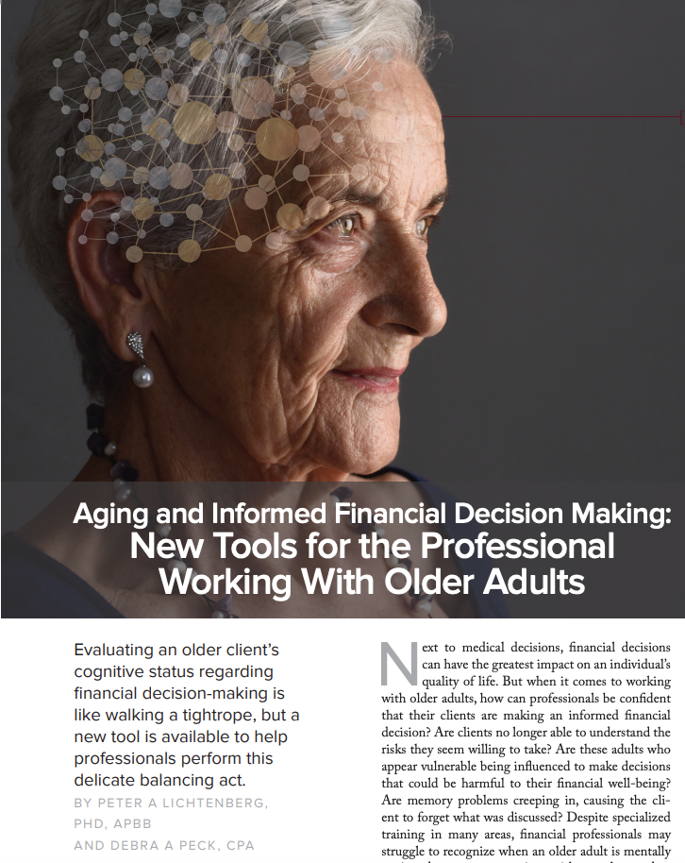
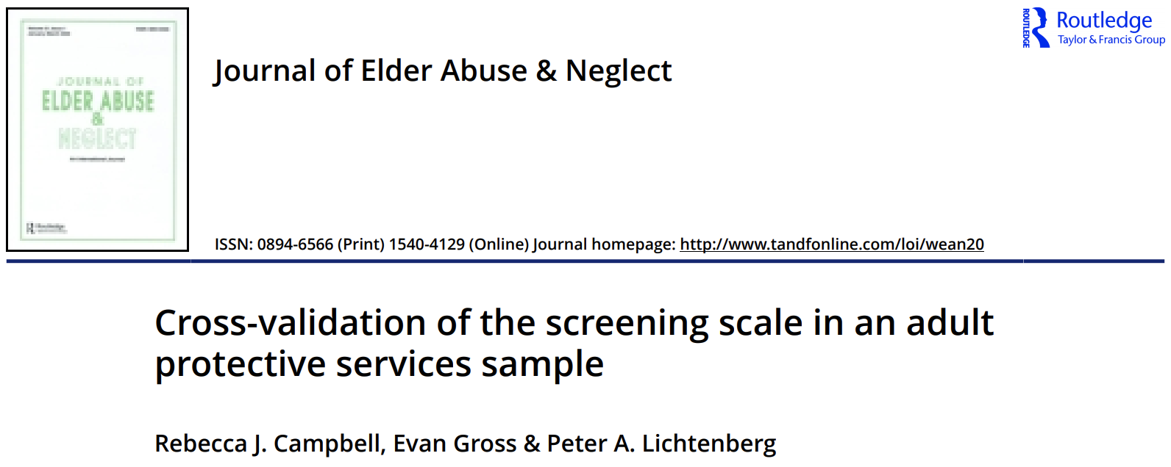
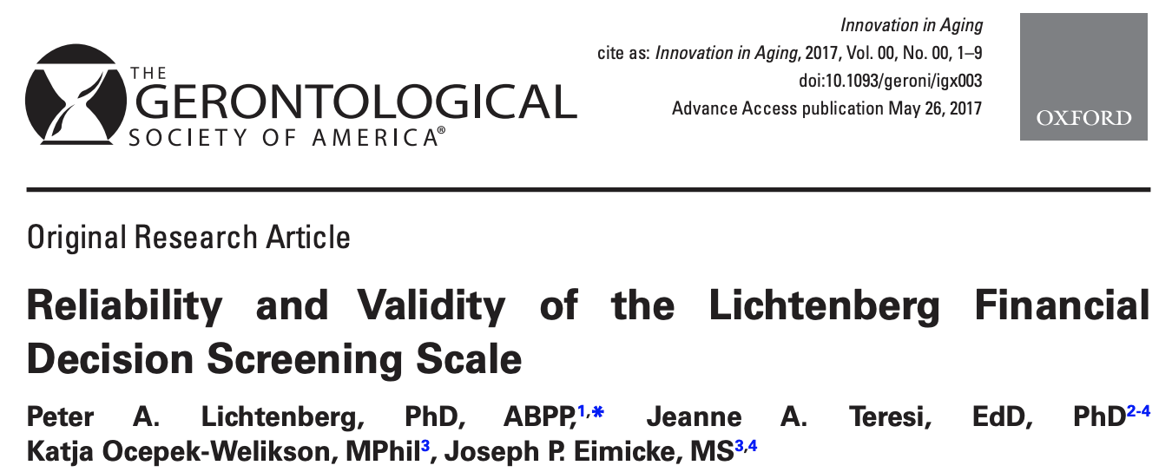
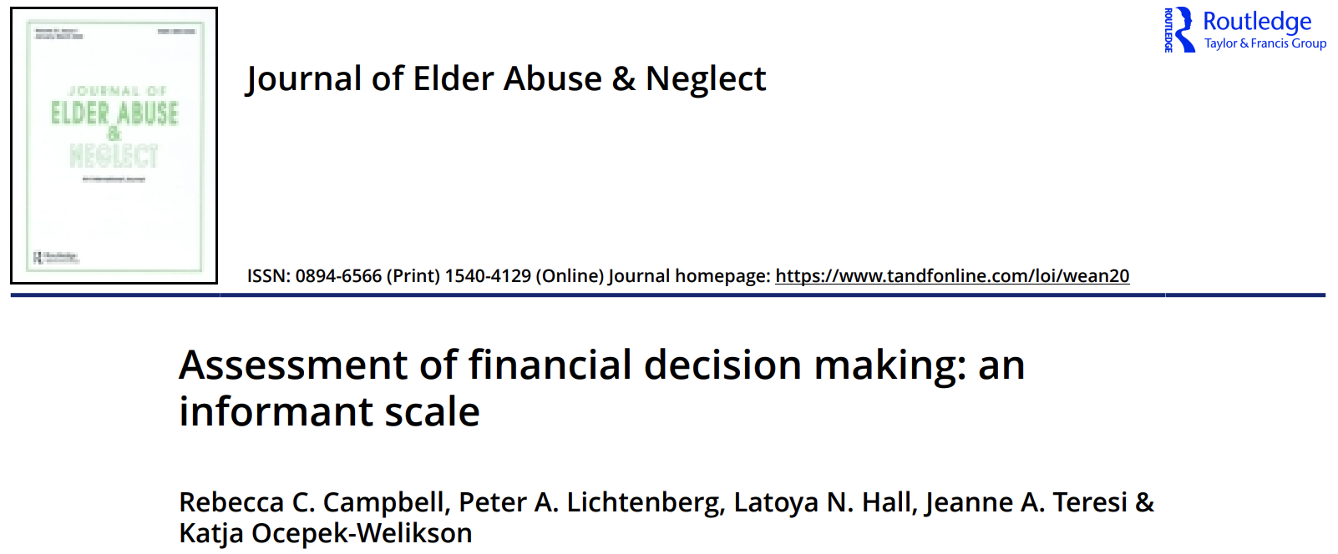
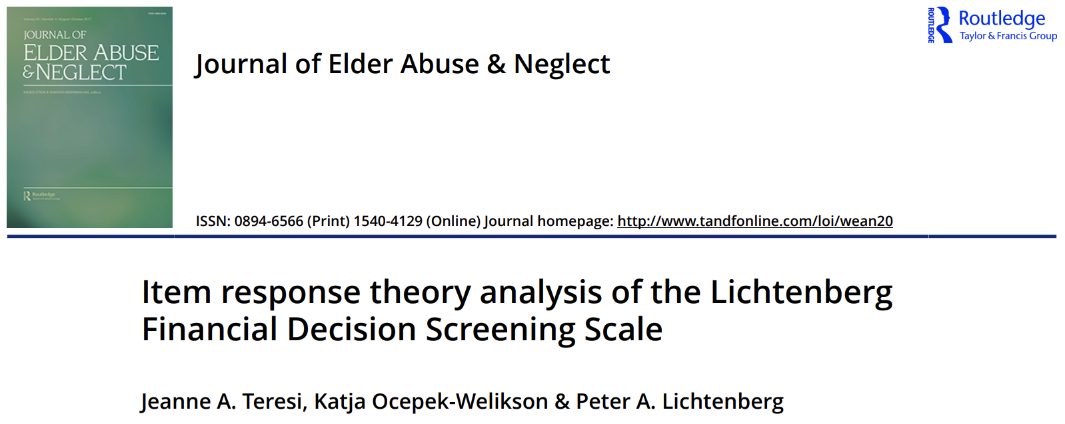

Slide 27
A 68-year-old high school graduate is considering buying a new home for her grandson.
She has relatively few resources herself and this purchase would put her at risk for financial hardship
She would be financially responsible should her grandson decide to no longer pay the monthly bills.
Grandson is marginally employed and has no financial resources; making an investment in him a significant risk.
FDT– lack of understanding—impact on finances and who benefits most
FDT—”Makes older person put their head into their decision—not just their heart”
Case Example

Slide 28
Financial decision-making deficits in scam cases (Lichtenberg et al., in press)
SUPPLEMENTARY TABLES FOR APPENDIX Table 1. Group comparison of demographics and FDT risk score based on interviewer’s concerns
 | No concern (n=60) | Some/Major Concern (n = 115) | Overall Sample (N = 175) | Group Comparison | Effect Size
Gender |  |  |  | X²(1) = .098, p = .56
Male | 25 | 48 | 73
Female | 35 | 67 | 102
Race |  |  |  | X²(1) = 2.184, p =.10
Black | 5 | 18 | 23
White (Non-Hispanic) | 55 | 95 | 150
Education |  |  |  | X²(1) = .062, p = .48
High School or Less | 28 | 54 | 82
More than High School | 16 | 28 | 44
Age in Years M(SD) | 77.37(8.49) | 76.10 (8.42) | 76.53 (8.44) | t(173) = 0.95, p = .35
FDT Risk Score M(SD) | 4.38 (2.69) | 7.99 (2.30) | 6.75 (2.98) | t(173) = -9.29, p < .001 | d=2.44

Slide 29
Table 2: Group comparison of scored FDT items based on interviewer’s concern
 | No concern (n=60) | Some/Major Concern (n = 115) | Overall Sample (N = 175) | Group Comparison | Effect Size
Was this your idea or did someone suggest it or accompany you? | .85 (.78) | 1.10 (.63) | 1.02 (.69) | t(173) = -2.34, p = .02 | d=.68
How will this decision impact you now and overtime? | 1.43 (.77) | 2.12 (.60) | 1.89 (.74) | t(173) = -6.55, p < .001 | d=.66
How much risk is there to your financial well-being? | .50 (.79) | 1.74 (.93) | 1.31 (1.06) | t(173) = -8.75, p < .001 | d=.89
How might someone else be negatively affected? | .35 (.66) | .81 (.75) | .65 (.75) | t(173) = -3.97, p < .001 | d=.72
Who benefits most from this financial decision? | .98 (.79) | 1.44 (.65) | 1.28 (.73) | t(173) = -4.06, p < .001 | d=.70
Does this decision change previous planned gifts or bequests to family, friends, or organizations? | .15 (.44) | .73 (.82) | .53 (.77) | t(173) = -5.06, p < .001 | d=.72
To what extent did you talk with anyone regarding this decision? | .05 (.22) | .08 (.27) | .07 (.25) | t(173) = -1.15, p = .25

Slide 31
Implementation Science
Implementation science examines the translation of evidence-based practices into widespread usage.
To do so, it uses scientific conceptual models and methods to discern processes that are not typically governed by rationality.
If the adoption of evidence-based practices were straightforward and rational, it would consist of adopting passive methods to disseminate evidence-based practices
https://www.OlderAdultNestEgg.com

Slide 32
Implementation Science Approach
Used for Conceptual Framework: Promoting Action in Research Implementation in the Health Sciences (PARIHS), Kitson (1998)
Basic Elements
Evidence—research quality and support
Context– environmental factors that support implementation or not
Facilitation– how is implementation facilitated and by whom
Website https://olderadultnestegg.com was key to widespread implementation
https://www.OlderAdultNestEgg.com

Slide 33
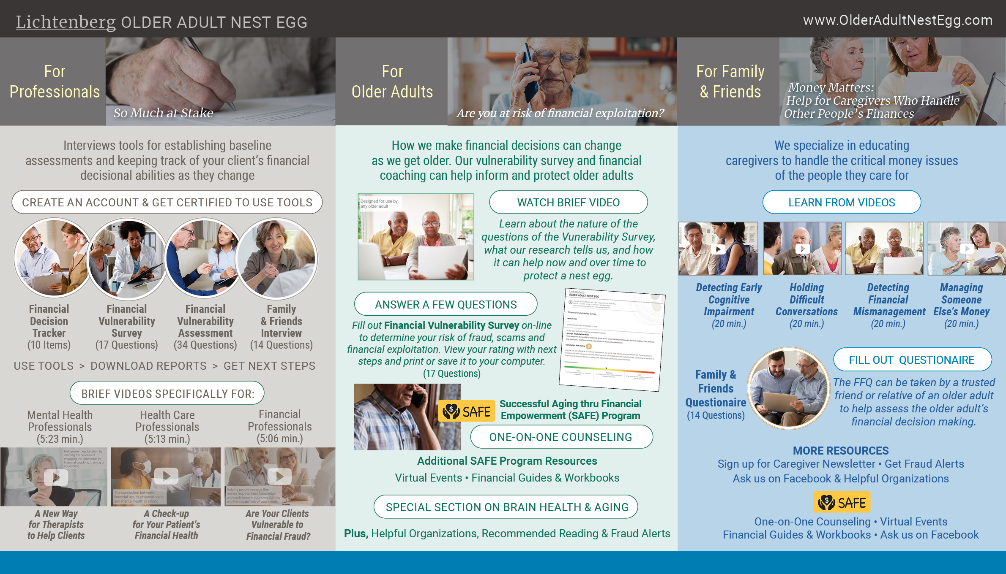

Slide 34
Trial
APS Statewide Implementation
Goal: Use our online training and scoring system to have all Michigan APS workers trained and certified and using the scale
Strategy: Provide in-person or webinar training to all APS center supervisors to train and certify them first; then give similar training to field staff and have them trained and certified.
Improvements to the system post-training allowed me to review each scale that was administered. Sent inquires to staff and supervisor for cases that had questions.

Slide 35
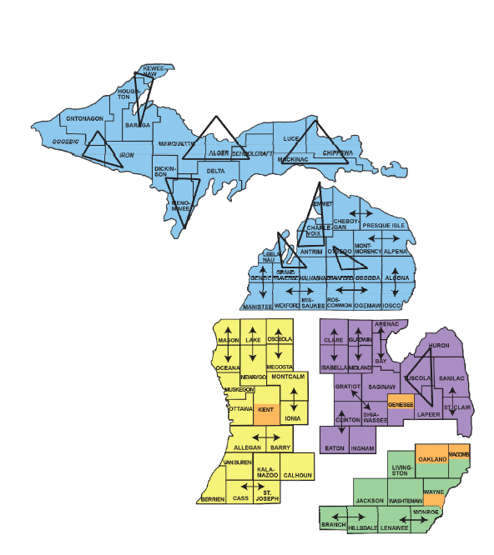
Michigan Adult Services Management Structure
83 counties
4 Business Services Centers
530 adult services workers
54 supervisors
5 program managers
Notes:
To better understand the rollout for this process I’ve included a map of Michigan. Adult Services oversees three programs with APS being one of them. Some workers only do APS while others manage all three programs.
Business Service Center 1 is in blue. There are 38 staff, 5 supervisors and 1 program manager to cover the 36 counties in northern Michigan. .
Business Service Center 2 in purple has 18 counties with 104 staff and 10 supervisors. The smallest county has 1 worker and the largest county has 27 workers.
Business Service Center 3 in yellow has 19 counties in Southwest Michigan. There are 99 staff with 10 supervisors and 1 program manager with both urban and rural counties.
Business Service Center 4 is in green. There are large urban areas here and small towns in this region. This region has 284 workers, 30 supervisors and 2 program managers. The largest county that includes Detroit has 140 workers.
As you can see there is a wide range of diversity when it comes to county size and staff resources. I point this out to show that we had to allow some flexibility in how the Financial Decision Tracker was rolled out to the counties. Having the 5 program managers oversee the training and rollout helped to streamline this process and monitor its success.

Slide 36

Training and Certification available on the Older Adult Nest Egg website
Each program manager had access to the sight to enroll their staff into the program.
Staff were given a notification to complete the training.
Program managers could monitor their training progress through the Older Adult Nest Egg website.
This Photo by Unknown Author is licensed under CC BY-SA

Slide 37

Field Implementation
1
Awareness
2
Training
3
Implementation
  Monitoring
4

Slide 38

Utilization of a Focus Group
This Photo by Unknown Author is licensed under CC BY-SA-NC

Slide 39
Key Take Aways from the Focus Group
Decision Tree to identify when to use the FDT.
Optional rephrased questions to use when needed.
How to use the FDT results in the APS investigation.

Slide 40
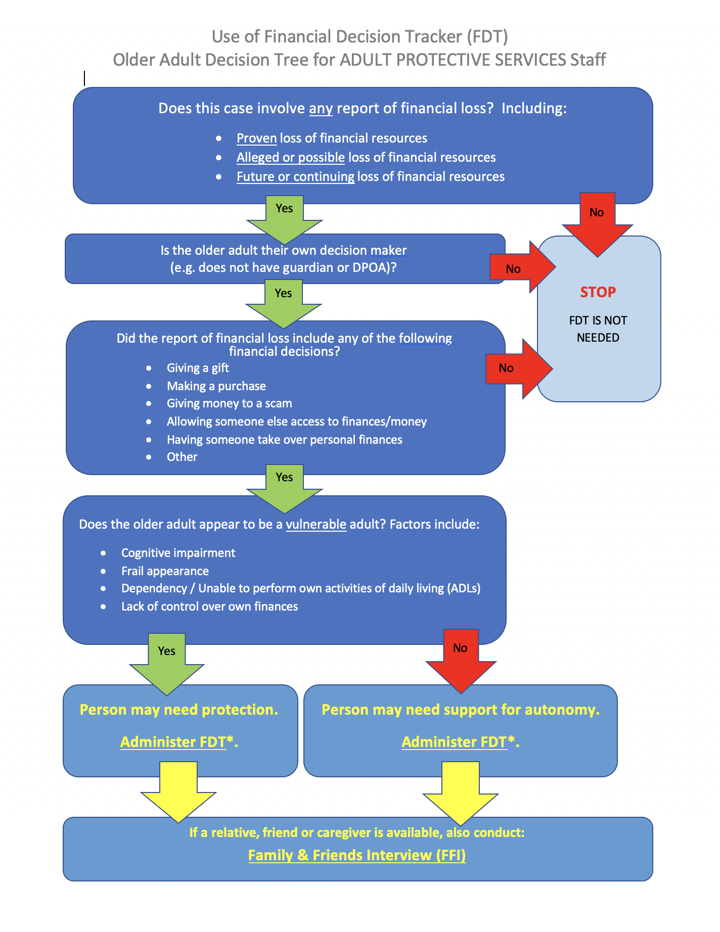
Use of the
Financial Decision Tracker (FDT)
Older Adult Decision Tree
ADULT PROTECTIVE SERVICES

Slide 41
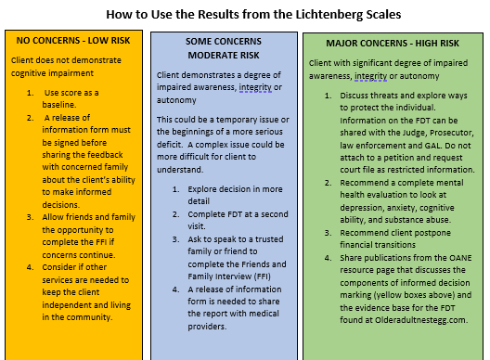
I have the results, now what do I do?
Low
Moderate
High
Notes:
When the results show LOW RISK
This is used as a baseline for future referrals.
When the results show MODERATE RISK
It’s recommended that the FDT be given again at a later date and/or use the Friends and Family Interview to gain more information to determine next steps.
When the results show HIGH RISK
Consider getting an evaluation completed by a medical provider
Meet with law enforcement and the prosecutor to consider legal action.

Slide 42

Case Example
APS worked with an older gentleman who befriended a woman and her girlfriend who both moved into the home. The family was concerned about financial exploitation.
This Photo by Unknown Author is licensed under CC BY-NC

Slide 43
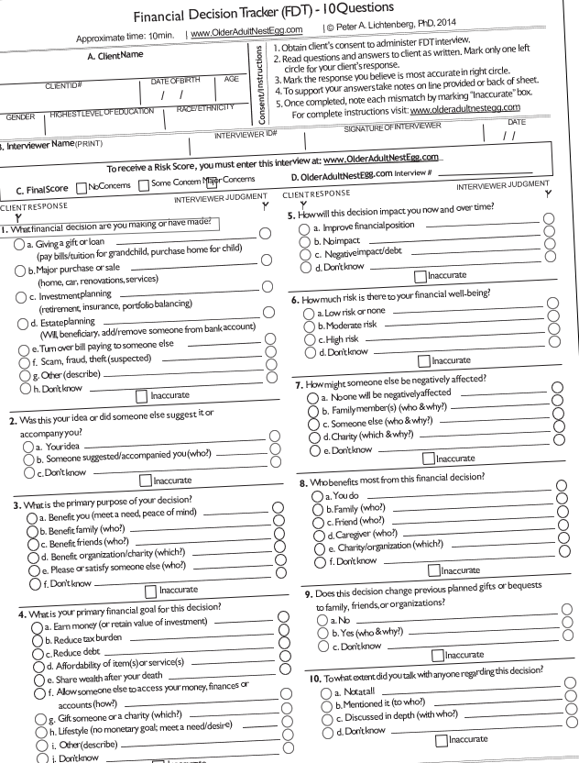
Using the FDT in the investigation
1. Using the Family and Friends Interview with the family
2. Using the Financial Decision Tracker with the client
3. Using the Family and Friends Interview with the potential perpetrator
Notes:
APS was called and the worker spoke to the family members first. He used the Friends and Family Interview to learn more about the situation. This helped him formulate his questions when he met with the client.
2. When APS went to the home to visit the client, the woman initially would not let APS in the door. APS was able to gain access to speak with the client and used the Financial Decision Tracker once the woman left the room. Through this discussion the client was able to realize that he was being taken advantage of.
3. APS used the Friends and Family Interview to interview the alleged perpetrator, the woman living in the home. The Friends and Family Interview allowed the woman to share her feedback on the situation. The woman was cooperative and appreciated time to speak to APS. Her answers were much different than what the family and client presented.

Slide 44

Impact of FDT and FFI on the Criminal Case
Information was shared with the prosecutor and the police.
This Photo by Unknown Author is licensed under CC BY-SA

Slide 45
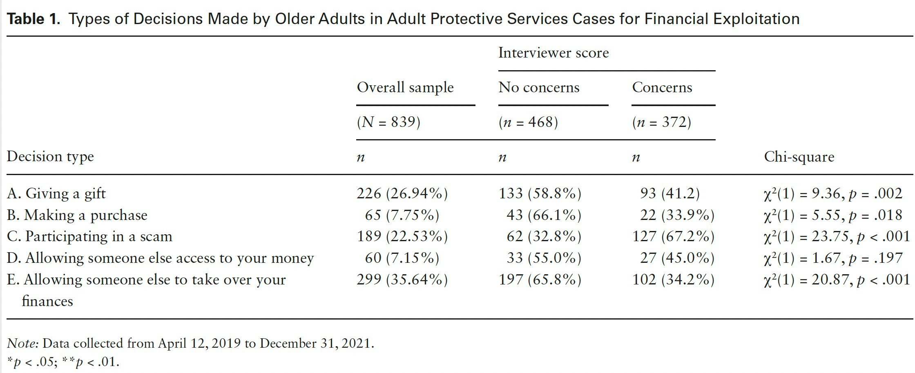
Types of Decisions Made by Older Adults in
Adult Protective Sevices Cases for Financial Exploitation
OlderAdultNestEgg.com

Slide 46
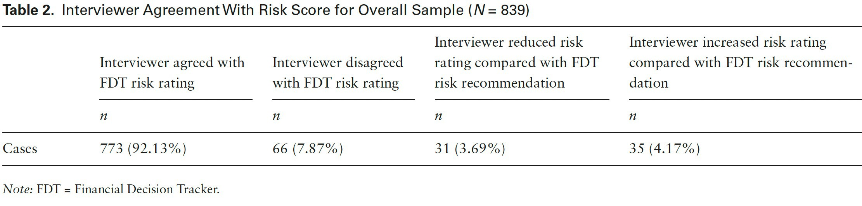
Interviewer Agreement with Risk Score for Overall Sample (N=839)
OlderAdultNestEgg.com

Slide 47
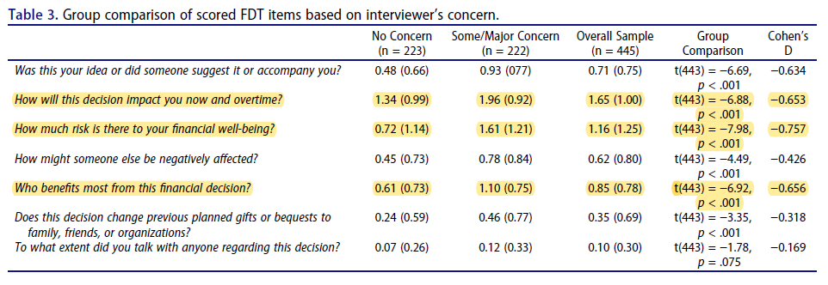
https://www.OlderAdultNestEgg.com

Slide 48
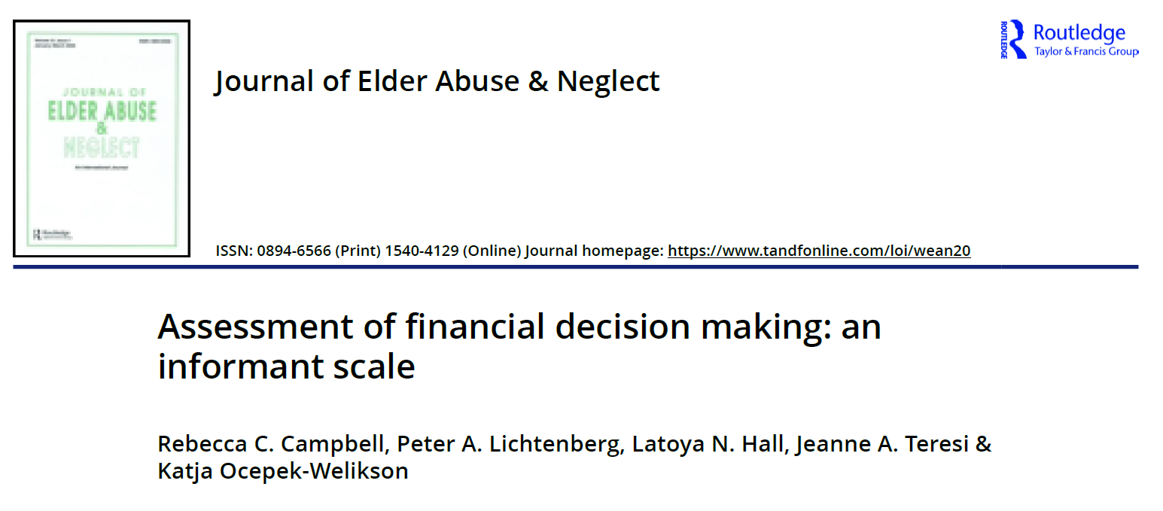
https://www.OlderAdultNestEgg.com

Slide 49
Question Stems for the Friends and Family Interview
Copyright Peter Lichtenberg, PhD 2017
To your knowledge, what type of financial decision or transaction did your relative or friend recently make or is thinking of making?
2. Was this decision their idea or did someone else suggest it?
Now and over time, how do you think this decision or transaction will impact your relative or friend financially?
How much risk is there that this decision could result in a negative impact, such as loss of funds?
Overall, how satisfied is your relative or friend with finances?
Who manages your relative’s or friend’s money day to day?
Is your relative or friend helping anyone financially on a regular basis?
How often does your relative or friend seem anxious or distressed about financial decisions?
9A. Is your relative’s or friend’s memory, thinking skills, or ability to reason with regard to finances worse than a year ago?
9B. Has this interfered with their everyday financial activities?
Does your relative or friend regret or worry about a financial decision or transaction they made or intend to make?
Would others, who know your relative or friend well, say the current major financial decision is unusual for them?
To your knowledge, how much has your relative or friend come to rely on just one person for all financial decisions?
Has anyone used or taken your relative’s or friend’s money without their permission?
How likely is it that anyone now wants to take or use your relative’s or friend’s money without their permission?
https://www.OlderAdultNestEgg.com

Slide 50
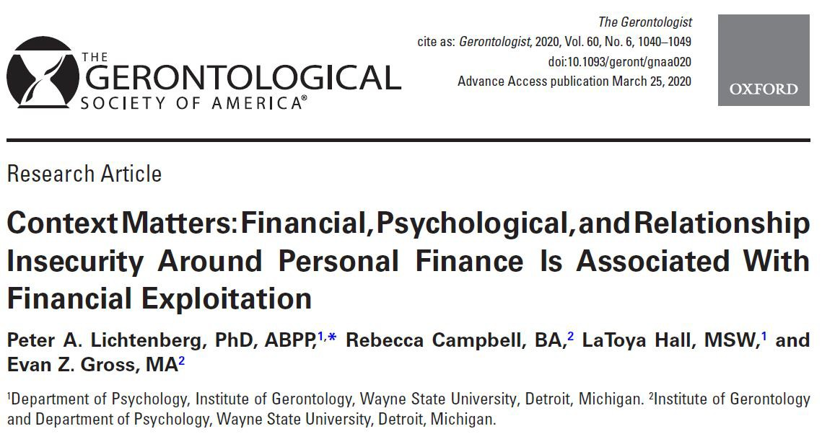

https://www.OlderAdultNestEgg.com

Slide 51
Context Matters
\
Moving towards prevention and assessing impact of FE—The Financial Vulnerability Survey
Financial, psychological and relationship strain and insecurity
differentiated FE (n=78) from non FE (n=168) group
17 items with Chronbach alpha .82, AUC .80 provided initial
construct validity for a new self-report survey:
Financial Exploitation Vulnerability Scale (FEVS)
On OlderAdultNestEgg.com
FEVS is referred to as the Financial Vulnerability Survey
https://www.OlderAdultNestEgg.com

Slide 52
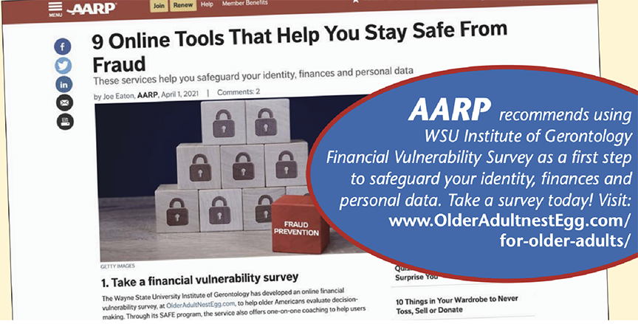

Slide 53
OlderAdultNestEgg.com
Financial Vulnerability Survey
Date
Age: Gender: Male Female Highest Level of Education Race/Ethicity
Do you live alone? YES NO Are you employed? YES NO
Are you: Married Life Partner (unmarried) Widowed Single
Secure ID Code:
Survey results will be sent to the person who asked you to complete it. Please enter that name or their organization here:
Instructions: Circle one answer per question
How worried are you about having enough money to pay for things?
  Not at all worried (0)
  Somewhat worried (1)
  Very worried (2)
How often do you wish you had someone to talk to about financial decisions, transactions, or plans?
  Never or rarely (0)
  Sometimes (1)
  Often (2)
Overall, how satisfied are you with your finances?
  Satisfied (0)
  Neither satisfied nor dissatisfied (1)
  Dissatisfied (2)
How often do you feel anxious about your financial decisions and/or transactions?
  Never or rarely (0)
  Sometimes (1)
  Often (2)
Who manages your money day-to-day?
  I do, without any help. (0)
  I get help from someone (1)
  Someone else manages all my money (2)
Do you have a confidante with whom you can discuss anything, including your financial situations and decisions?
  Yes (0)
  No (1)
How satisfied are you with this money management arrangement?
  Satisfied (0)
  Neither satisfied nor dissatisfied (1)
  Dissatisfied (2)
How often do you feel downhearted or blue about your financial situation or decisions?
  Never or rarely (0)
  Sometimes (1)
  Often (2)
How confident are you in making big financial decisions?
  Confident (0)
  Unsure (1)
  Not confident (2)
*Are your memory, thinking skills, or ability to reason with regard to financial decisions or financial transactions worse than a year ago?
  No (0)
  Yes (1)
How often do you worry about financial decisions you’ve recently made?
  Never or rarely (0)
  Sometimes (1)
  Often (2)
Has a relationship with a family member or friend become strained due to finances as you have gotten older?
  No (0)
  Yes (1)
Have you noticed any money taken from your bank account without your permission?
  No (0)
  Yes (1)
Did anyone ever tell you that someone else you know wants to take your money?
  No (0)
  Yes (1)
How often do your monthly expenses exceed your regular monthly income?
  Never or rarely (0)
  Sometimes (1)
  Often (2)
How likely is it that anyone now wants to take or use your money without your permission?
  Unlikely (0)
  Somewhat likely (1)
  Very likely (2)
How often do you talk with or visit others on a regular basis?
  Daily or weekly (0)
  Monthly (1)
  Less than monthly (2)
Version 1/19/21

Slide 54
  OlderAdultNestEgg.com | Financial Vulnerability Survey
Instructions: Circle one answer per question
How worried are you about having enough money to pay for things?
a. Not at all worried (0) b. Somewhat worried (1) c. Very Worried (2)
Overall, how satisfied are you with your finances?
  a. Satisfied (0) b. Neither satisfied nor dissatisfied (1) c. Dissatisfied (2)
Who manages your money day-to-day?
a. I do, without any help(0) b. I get help from someone (1)
c. Someone else manages all my money (2)

Slide 55
  OlderAdultNestEgg.com | Financial Vulnerability Survey
4) How satisfied are you with this money management?
a. Satisfied (0) b. Neither satisfied nor dissatisfied (1) c. Dissatisfied (2)
5) How confident are you in making big financial decisions?
a. Confident (0) b. Unsure (1) c. Not Confident (2)
6) How often do you worry about financial decisions you’ve recently made?
a. Never or rarely (0) b. Sometimes (1) c. Often (2)

Slide 56
  OlderAdultNestEgg.com | Financial Vulnerability Survey
7) Have you noticed any money taken from your bank account without
your permission?
a. No (0) b. Yes (1)
8) How often do your monthly expenses exceed your regular monthly
income?
a. Never or rarely (0) b. Sometimes (1) c. Often (2)
9) How often do you talk with or visit others on a regular basis?
a. Daily or weekly (0) b. Monthly (1) c. Less than monthly (2)

Slide 57
  OlderAdultNestEgg.com | Financial Vulnerability Survey
10) How often do you wish you had someone to talk to about financial
decisions, transactions, or plans?
a. Never or rarely (0) b. Sometimes (1) c. Often (2)
11) How often do you feel anxious about your financial decisions and/or
transactions?
a. Never or rarely (0) b. Sometimes (1) c. Often (2)
12) Do you have a confidante with whom you can discuss anything,
including your financial situations and decisions?
a. Yes (0) b. No (1)

Slide 58
  OlderAdultNestEgg.com | Financial Vulnerability Survey
13) How often do you feel downhearted or blue about your financial
situation or decisions?
a. Never or rarely (0) b. Sometimes (1) c. Often (2)
14) Are your memory, thinking skills, or ability to reason with regard to
financial decisions or financial transactions worse than a year ago?
a. No (0) b. Yes (1)
15) Has a relationship with a family member or friend become strained
due to finances as you have gotten older?
a. No (0) b. Yes (1)

Slide 59
  OlderAdultNestEgg.com | Financial Vulnerability Survey
16) Did anyone ever tell you that someone else wants to take your money?
a. No (0) b. Yes (1)
How likely is it that anyone now wants to take or use your money
without your permission?
  a. Unlikely (0) b. Somewhat likely (1) c. Very likely (2)

Slide 60
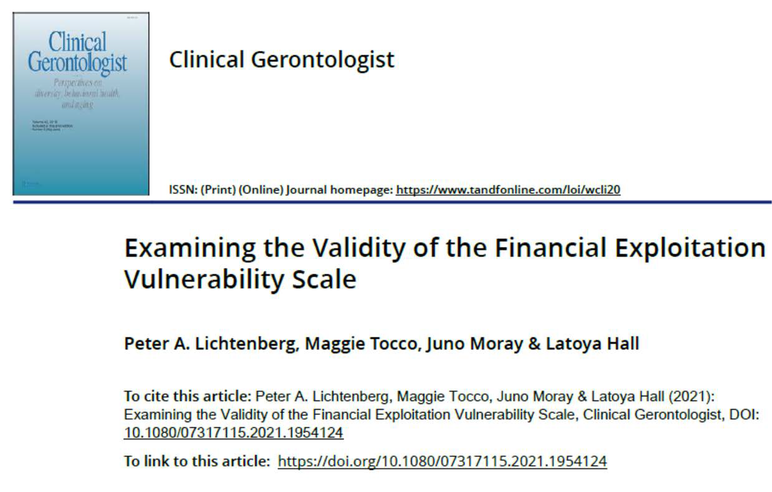
https://www.OlderAdultNestEgg.com

Slide 61
Findings from Study
N=248 anonymous surveys who reported being over age 60.
Those who reported to have a less reliable memory than one-year ago had significantly higher scores (risk for FE).
Those who lived alone had significantly higher scores (risk for FE).
Those who reported memory problems and lived alone were the highest risk for FE group.

Slide 63
Older Adult Nest Egg Website
4-year Statistics
Total number of training sessions completed
4,859
Scales Administered
FDT = 2,139
FVS = 1,908
(only on site past 2 years)
All Scales = 4,793
(includes FVA & FFI)
https://olderadultnestegg.com

Slide 64
Summary and Call to Action
New conceptual model and evidence-based scales to assess informed financial decision-making for a specific decision.
Our experience with Implementation Science of 10 item scale in APS
Moving toward Prevention and Assessing Impact
Our 17-item self-report measure
Call to Action: GET TRAINED, USE EVIDENCE BASED TOOLS TO
HELP YOUR OLDER CLIENTS

